Slide 2
What's New With SIG-Windows and
Deep Dive Into Windows Container Users
Mark Rossetti, Microsoft Brandon Smith, Microsoft
Jay Vyas, VMware
Claudiu Belu, Cloudbase Solutions

Slide 3
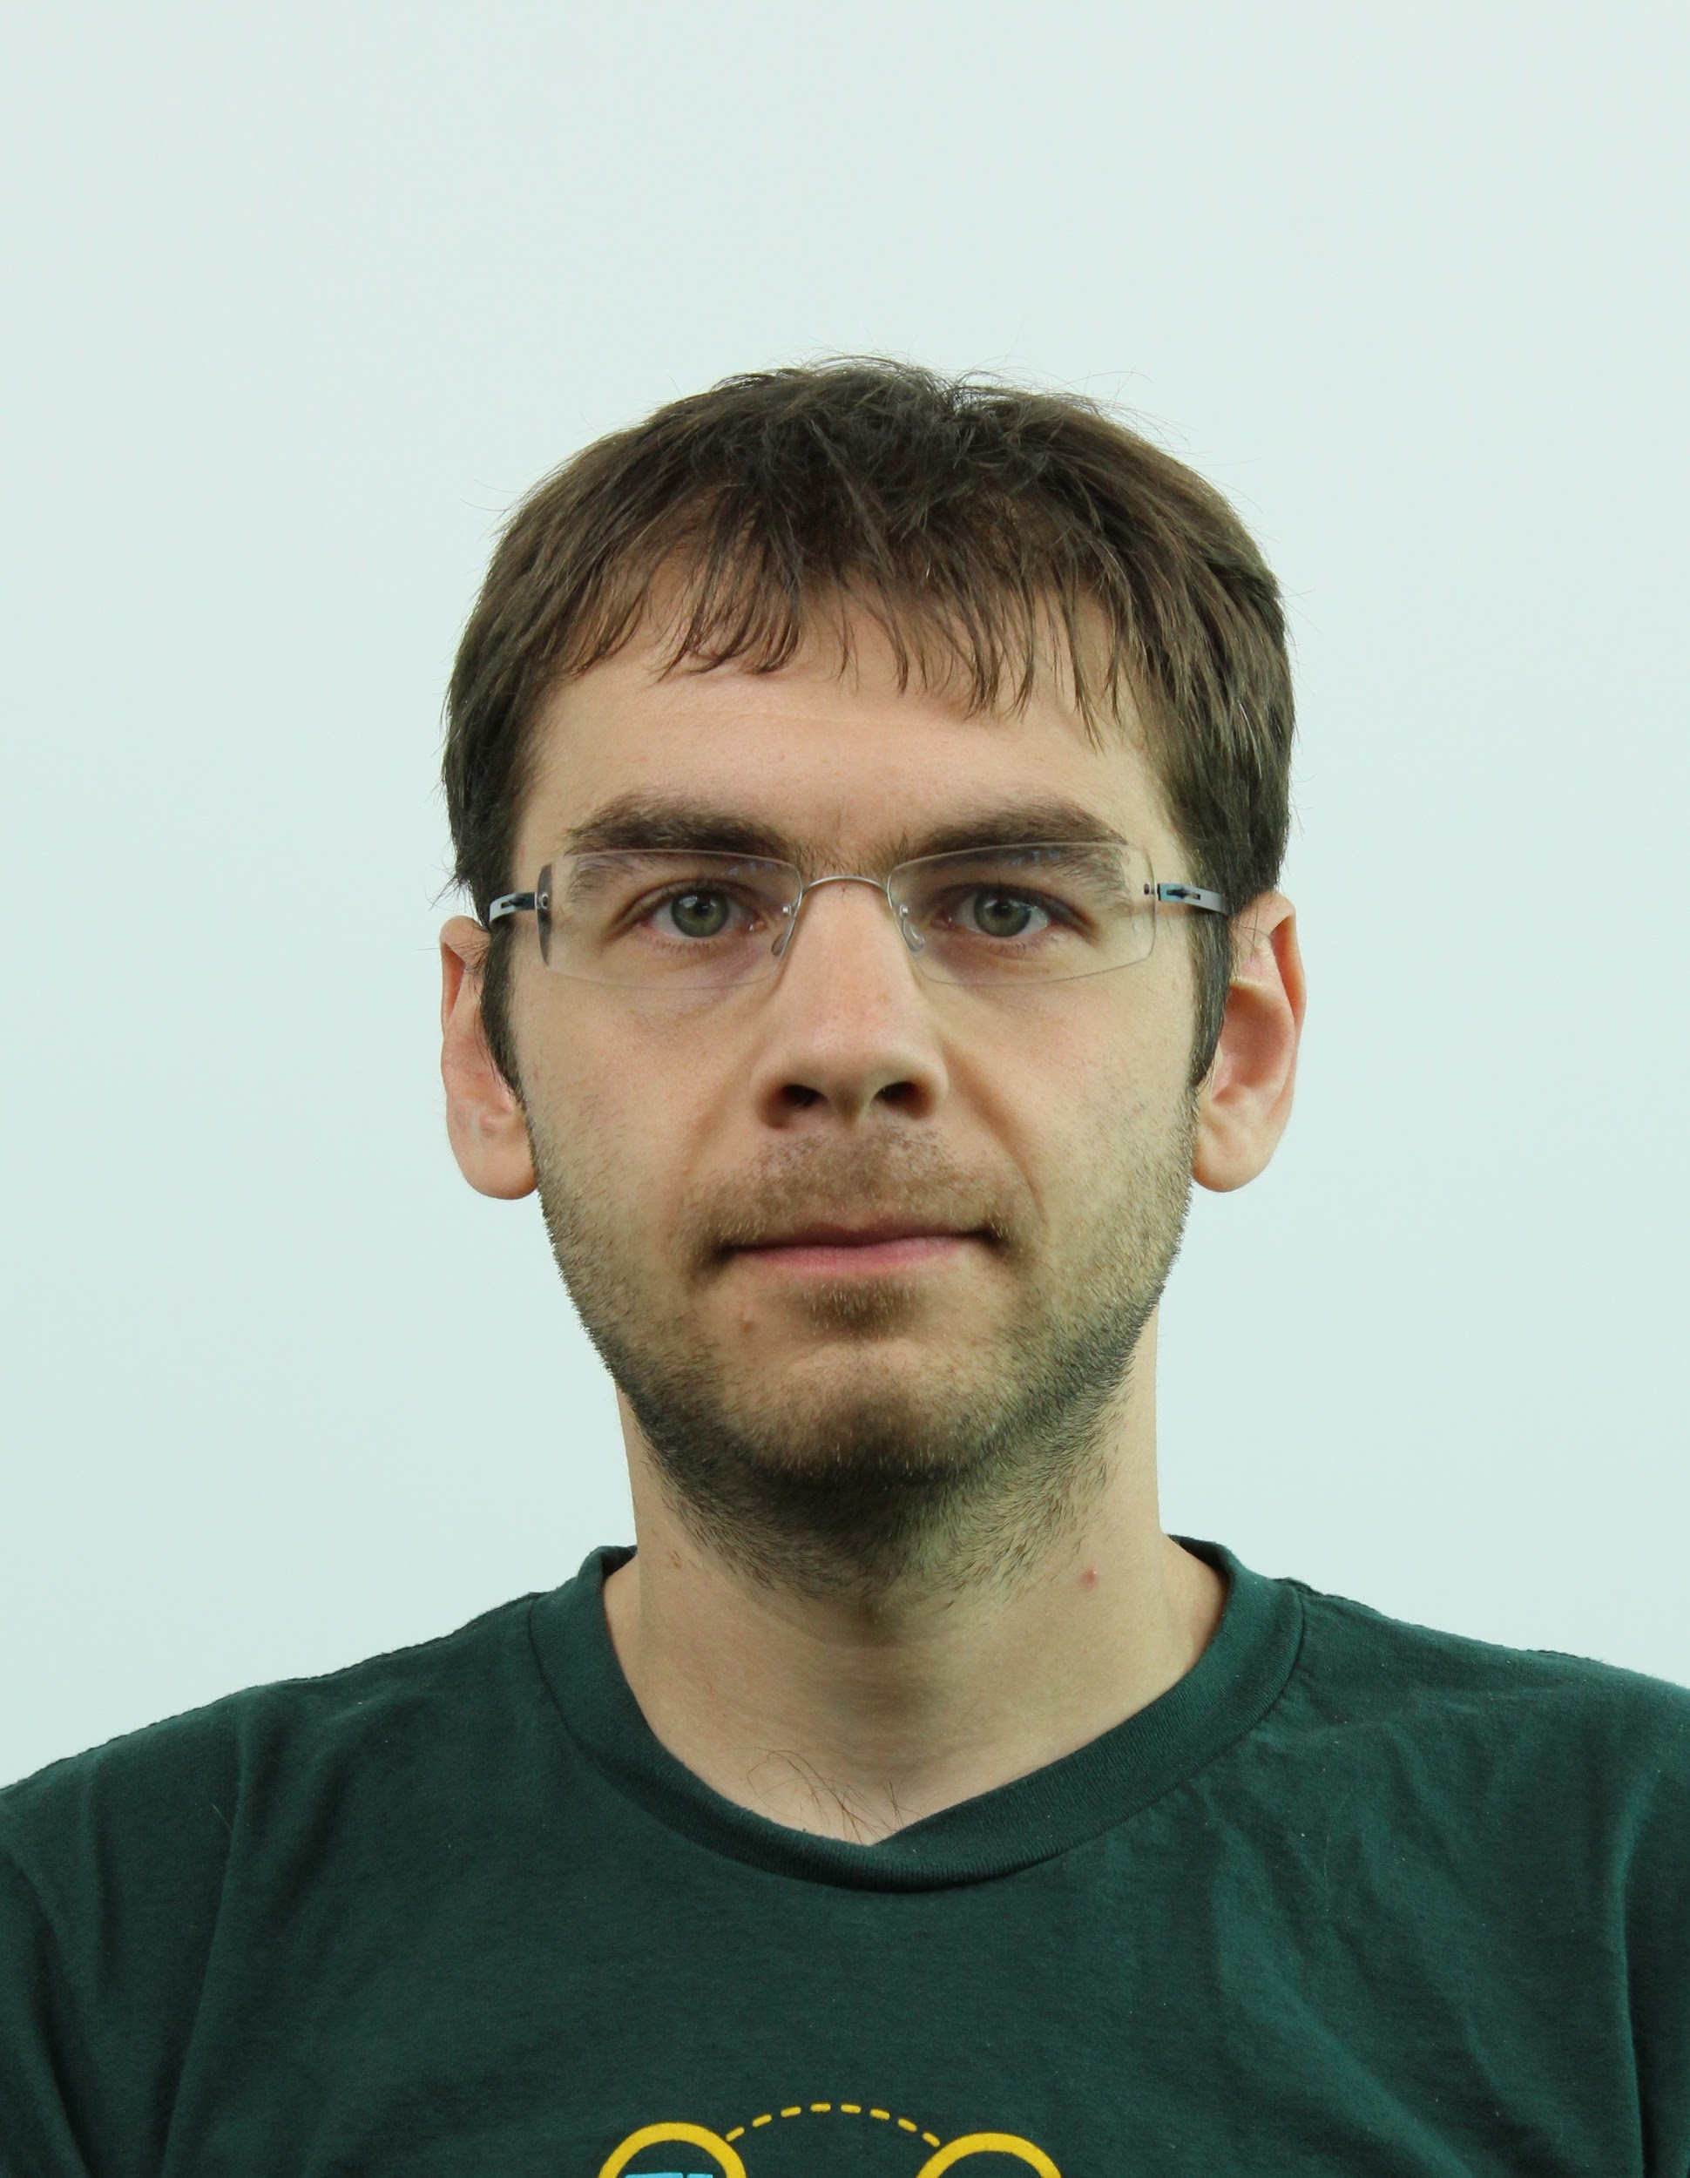



Speaker Introductions
Mark Rossetti Software Engineer Microsoft
@marosset / GitHub
@Mark Rossetti / K8s slack
Brandon Smith Product Manager Microsoft
@brasmith-ms / GitHub
@Brandon Smith (MS) / K8s
Jay Vyas Staff Engineer VMWare
@jayunit100 (tw/gh)
Claudiu Belu Cloud Engineer Cloudbase Solutions
@claudiubelu / GitHub
@Claudiu Belu / K8s slack

Slide 4
Agenda
What’s new
Container Users
KPNG: Next gen Kube Proxy for windows updates
What’s Next and Additional Resources

Slide 5
Updates

Slide 6
GMSA
“V2”
Ability to run container images as gMSA identities without requiring host to be domain joined through the use of CCG (Container Credential Guard) plugins making it much easier to manage Windows nodes
Support added in https://github.com/kubernetes-sigs/windows-gmsa/releases/tag/v0.3.0
Reference plugin implementation available at https://github.com/microsoft/Azure-Key-Vault-Plugin-gMSA
More information can be found at https://docs.microsoft.com/en-us/virtualization/windowscontainers/manage-containers/manage-serviceaccounts
Helm chart for deployment!

Slide 7
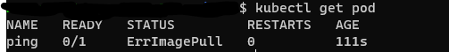
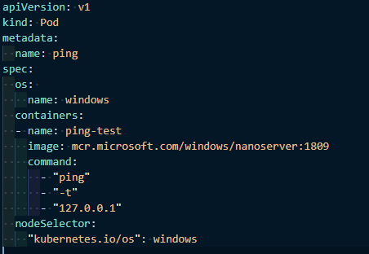
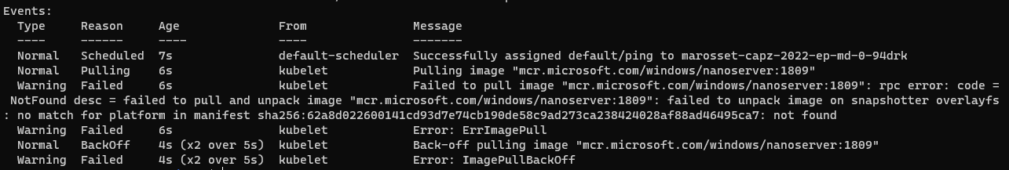
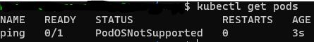
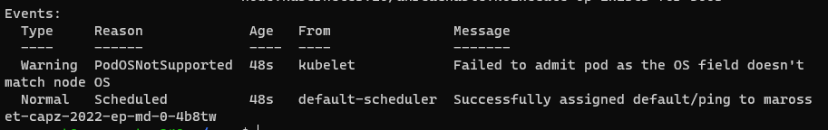
Pod OS Field
Windows container accidently scheduled to linux nodes
Old behavior
Promoted to Beta in 1.24 (on by default)
Currently NOT used for scheduling
Allows for enhanced pod validation and error reporting
No default values!
New behavior

Slide 8
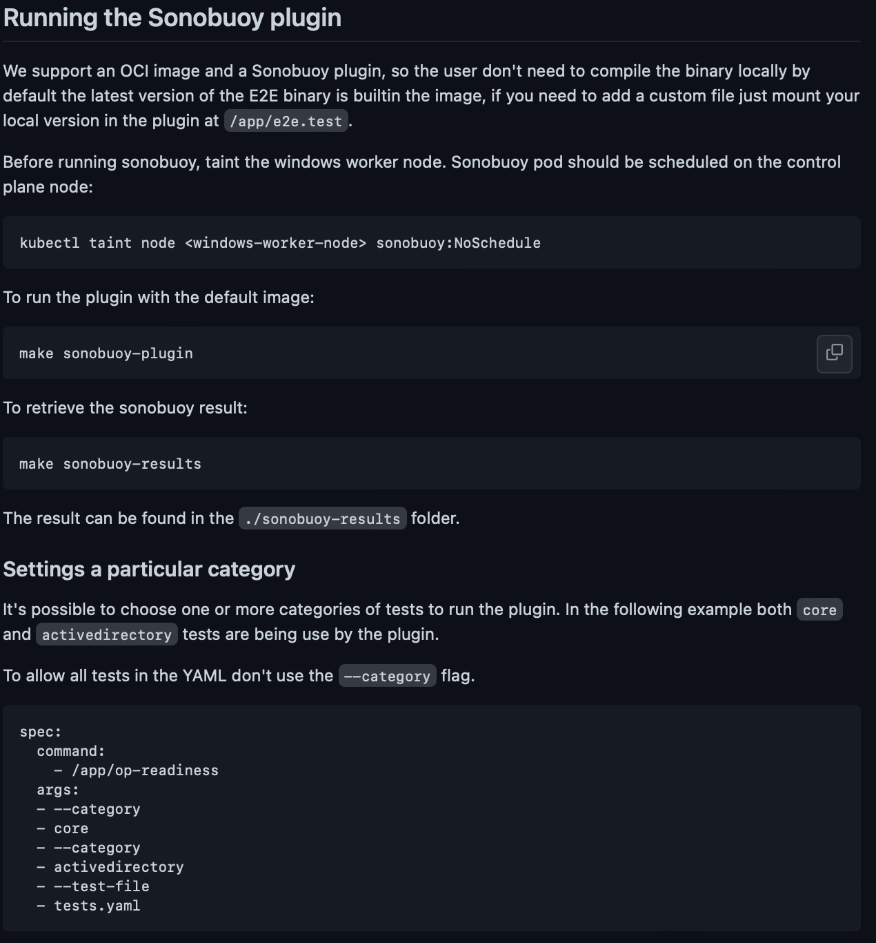
Operational Readiness Specification For Windows (i.e. Windows Conformance)
Checkout our introduction to Windows Multi-OS clusters on Antrea live, https://www.youtube.com/watch?v=Z_1dI-yR_Fw
Test it out as a sonobuoy plugin for an easy to understand way to evaluate your supported windows functionality on Kubernetes !
https://github.com/K8sbykeshed/op-readiness

Slide 9
Container Users

Slide 10
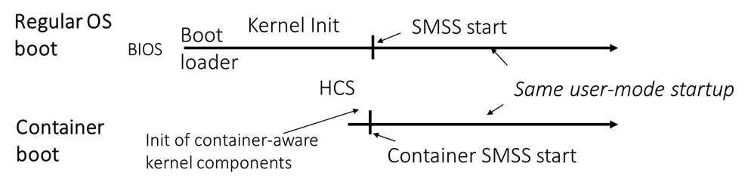
Booting Windows Server Containers

Slide 11
Container Security Spectrum
Quotas and limits
State isolation
Multi-tenant security
Hardware virtualization
Process
Process with cgroups
Docker
(LXC++)
Kata Containers
Virtual Machine
Linux
Process
JobObject++
Windows Server Containers
Hyper-V Containers
Hyper-V Virtual Machine
Windows
Faster and more efficient
More isolated and secure

Slide 12
“Sphere of influence”
Administrator
Both the host Administrator and ContainerAdministrator are members of Builtin\Administrators!
The container assumes isolation from the host, all instances of the well-known Builtin\Administrators group share the same SID
ContainerAdministrator
ContainerUser

Slide 13
ContainerAdministrator
Privilege Name | State
SeIncreaseQuotaPrivilege | Disabled
SeSecurityPrivilege | Disabled
SeTakeOwnershipPrivilege | Disabled
SeLoadDriverPrivilege | Disabled
SeSystemProfilePrivilege | Disabled
SeSystemtimePrivilege | Disabled
SeProfileSingleProcessPrivilege | Disabled
SeIncreaseBasePriorityPrivilege | Disabled
SeCreatePagefilePrivilege | Disabled
SeBackupPrivilege | Disabled
SeRestorePrivilege | Disabled
SeShutdownPrivilege | Disabled
SeDebugPrivilege | Disabled
SeSystemEnvironmentPrivilege | Disabled
SeChangeNotifyPrivilege | Enabled
SeRemoteShutdownPrivilege | Disabled
SeUndockPrivilege | Disabled
SeManageVolumePrivilege | Disabled
SeImpersonatePrivilege | Enabled
SeCreateGlobalPrivilege | Enabled
SeIncreaseWorkingSetPrivilege | Disabled
SeTimeZonePrivilege | Disabled
SeCreateSymbolicLinkPrivilege | Disabled
SeDelegateSessionUserImpersonatePrivilege | Disabled
What can it do?
Install user mode services and software (i.e. IIS) that persist across the build and deployment cycle
Make container OS configuration changes
Create new user accounts with container admin rights
What can’t it do?
Directly interact with the host without permission
What it shouldn’t do:
Run application-sensitive workloads
Be given access to the host filesystem (use HostProcess!)

Slide 14
ContainerUser
Privilege Name | State
SeChangeNotifyPrivilege | Enabled
SeIncreaseWorkingSetPrivilege | Disabled
What if I want something with more specific permissions?
Create the user with custom permissions using ContainerAdministrator at build time, through tools like secedit, Set-Privilege cmdlet, or ntrights.exe.
What can it do?
Prevent against accidental misconfiguration and limit attack surface for hostile workloads
Run application workloads that do not require special privileges
What can’t it do?
Install user mode services
Make container OS configuration changes
Create new accounts
Directly interact with the host without permission
What it shouldn’t do:
Run application-sensitive workloads
Be given access to the host filesystem (use HostProcess!)

Slide 15
Kube-Proxy Next Gen

Slide 16
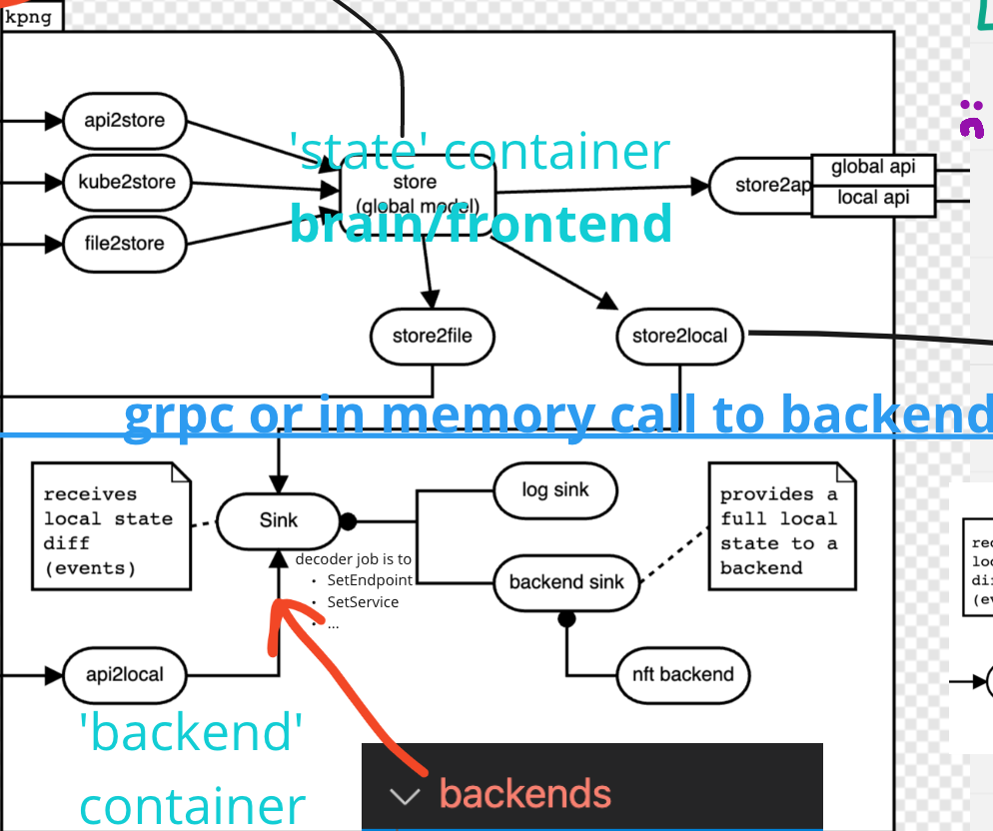
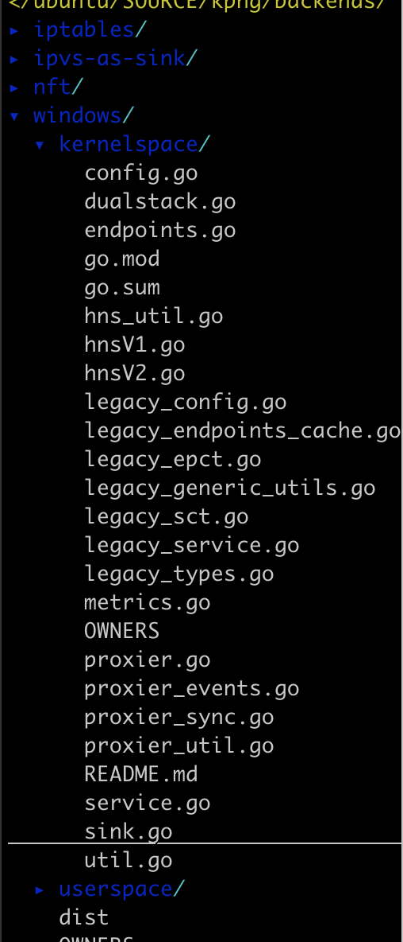
KPNG windows… kernel and userspace ports

Slide 17
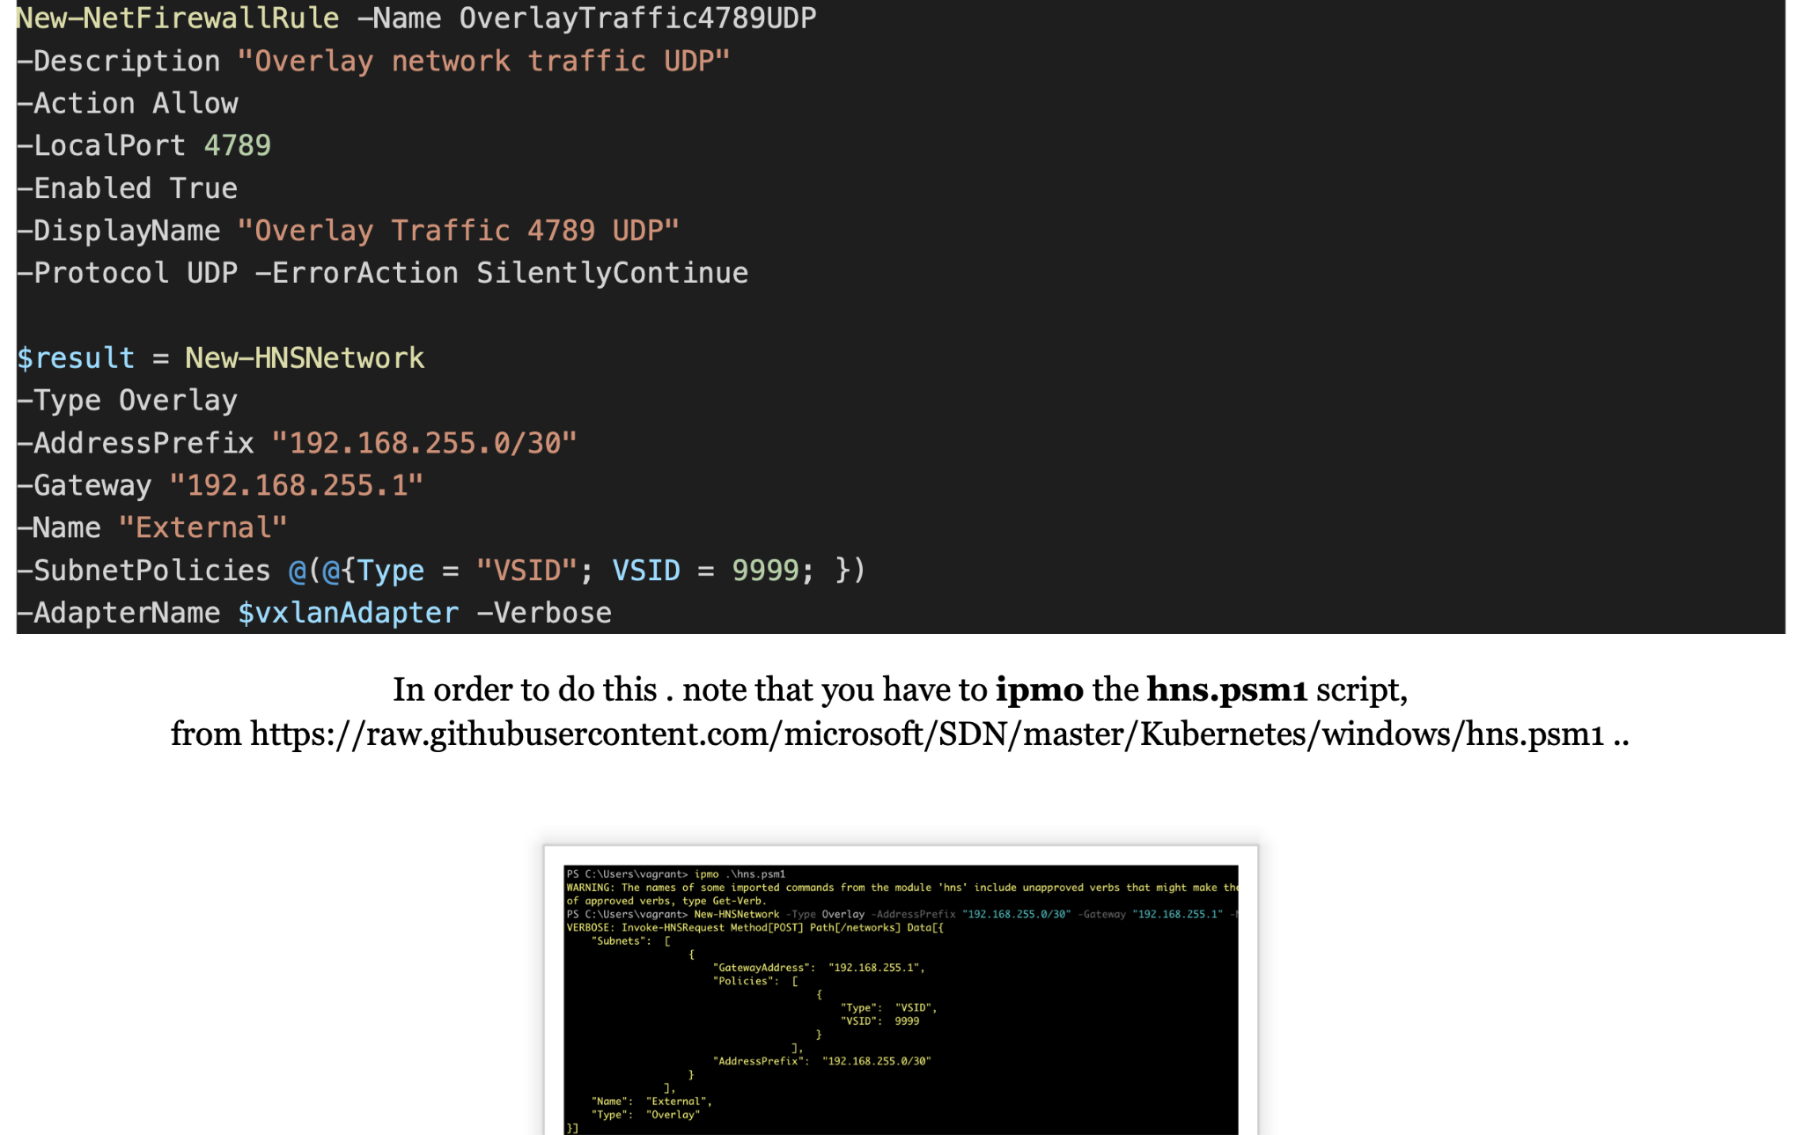
KPNG windows : How to test it….
Reduce the amount of work windows nodes need to do by eliminating direct Kube connection to APIServer
Eliminate the need to share linux and windows logic in the Kube proxy by making a windows specific backend with its own configuration
Create Network Gateways automatically as part of Kube proxy https://github.com/kubernetes/kubernetes/issues/109438
Home for the Windows Userspace proxy now that it is deprecated in-tree
Develop it with KPNG, https://jayunit100.blogspot.com/2022/03/my-dev-workflow-for-kpng-windows.html

Slide 18
What’s Next and Additional Resources

Slide 19
What’s Next
HNS performance enhancements
Reduce time it takes to sync rules in clusters with lots of services
HostProcessContainers usability improvements
More options for RunAs users
Predictable volume mount paths
`kubectl logs` work
https://github.com/kubernetes/enhancements/issues/2258
Perf tests for Windows nodes
File ACL improvements

Slide 20
Special Thanks and New Contributors
Special Thanks
David Schott - For all the help related to Windows network internals
Aravindh Puthiyaparambil - For all the help with docs, bug triage, code contributions, and more
Jamie Phillips - For contributions to the gMSA webhook - including helm charts
Ravi Gudimetla - For code contributions and running our weekly CI signal triage meeting
Yongkun Gui - For performance improvements to load balancers in Windows kube-proxy
Danny Canter - For Windows containerd work and HostProcessContainers support
Scott Rosenberg - and TeraSky for work on multi OS clusters with Cluster API Providers
Doug Schilling, Mikael Cluseau, Amim Knabben - for helping with Windows Kernel proxy KPNG
New Contributors
Xinqi Li - For wImproving gGMSA tests and operational readiness specification impl
Marius Oprin - For work on performance testing for Windows
Christian Glombek - For work on the node log viewers enhancement

Slide 21
How To Contribute
Visit our SIG-Windows community page
Follow our contributing guide
Join our community meetings (12:30pm EST every tuesday)
Join our SIG-Windows pairing sessions: https://github.com/kubernetes-sigs/sig-windows-samples/blob/master/PAIRING.md (right after the main meeting)
Help us write additional documentation and user stories
File bugs or review open PRs from our project board Content

Slide 22





Community Resources
Mark Rossetti
Co-Chair
Microsoft
@Mark Rossetti [Slack]
@marosset [GitHub]
Jay Vyas
Technical Lead
VMWare
@jayunit100 [Slack / GitHub]
James Sturtevant
Technical Lead
Microsoft
@jsturtevant [Slack / GitHub]
Claudiu Belu
Technical Lead Cloudbase Solutions
@Claudiu Belu [Slack]
@claudiubelu [Github]
Slack.k8s.io
#sig-windows
https://groups.google.com/forum/#!forum/kubernetes-sig-windows
https://kubernetes.io/docs/setup/production-environment/windows/
https://github.com/kubernetes/community/tree/master/sig-windows
YouTube Playlist
https://zoom.us/j/94389601840
Every Tuesday @ 12.30pm EST

Slide 23
Q & A

